Slide 1
Distributed Systems Design COMP 6231
Processes
Lecture 4
Essam Mansour

Slide 2
Today…
Last Session:
Processes
Threads
Virtualization
Today’s Session:
Client
Server
Code migration

Slide 3
Use of Virtualization Today
Data centers:
server consolidation: pack multiple virtual servers onto a smaller number of physical server
saves hardware costs, power and cooling costs
Cloud computing: rent virtual servers
cloud provider controls physical machines and mapping of virtual servers to physical hosts
User gets root access on virtual server
Desktop computing:
Multi-platform software development
Testing machines
Run apps from another platform

Slide 4
Types of virtualization
Para-virtualization
VM does not simulate hardware
Use special API that a modified guest OS must use
Hypercalls trapped by the Hypervisor and serviced
Xen, VMWare ESX Server
OS-level virtualization
OS allows multiple secure virtual servers to be run
Guest OS is the same as the host OS, but appears isolated
apps see an isolated OS
Solaris Containers, BSD Jails, Linux Vserver, Linux containers, Docker
Application level virtualization
Application is gives its own copy of components that are not shared
(E.g., own registry files, global objects) - VE prevents conflicts
JVM, Rosetta on Mac (also emulation), WINE

Slide 5
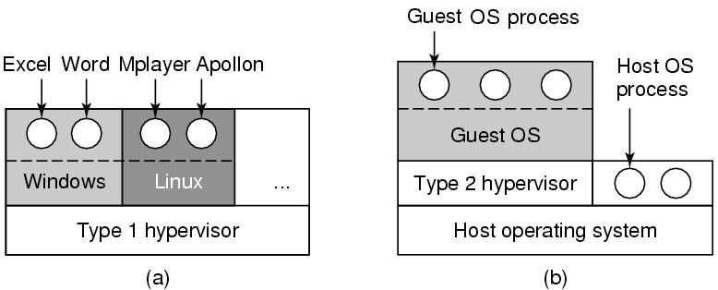
Types of Hypervisors
Type 1: hypervisor runs on “bare metal”
Type 2: hypervisor runs on a host OS
Guest OS runs inside hypervisor
Both VM types act like real hardware

Slide 6
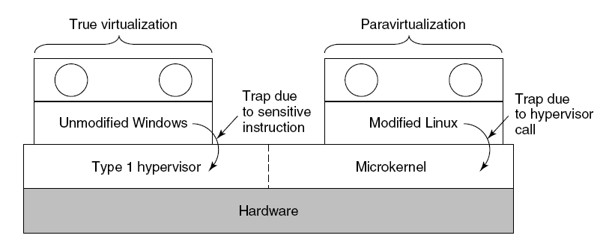
Paravirtualization
Both type 1 and 2 hypervisors work on unmodified OS
Paravirtualization: modify OS kernel to replace all sensitive instructions with hypercalls
OS behaves like a user program making system calls
Hypervisor executes the privileged operation invoked by hypercall.

Slide 7
Paravirtualization

Slide 8
Memory virtualization
OS manages page tables
Create new pagetable is sensitive -> traps to hypervisor
hypervisor manages multiple OS
Need a second shadow page table
OS: VM virtual pages to VM’s physical pages
Hypervisor maps to actual page in shadow page table
Two level mapping
Need to catch changes to page table (not privileged)
Change PT to read-only - page fault
Paravirtualized - use hypercalls to inform

Slide 9
I/O Virtualization
Each guest OS thinks it “owns” the disk
Hypervisor creates “virtual disks”
Large empty files on the physical disk that appear as “disks” to the guest OS
Hypervisor converts block # to file offset for I/O
DMA need physical addresses
Hypervisor needs to translate

Slide 10
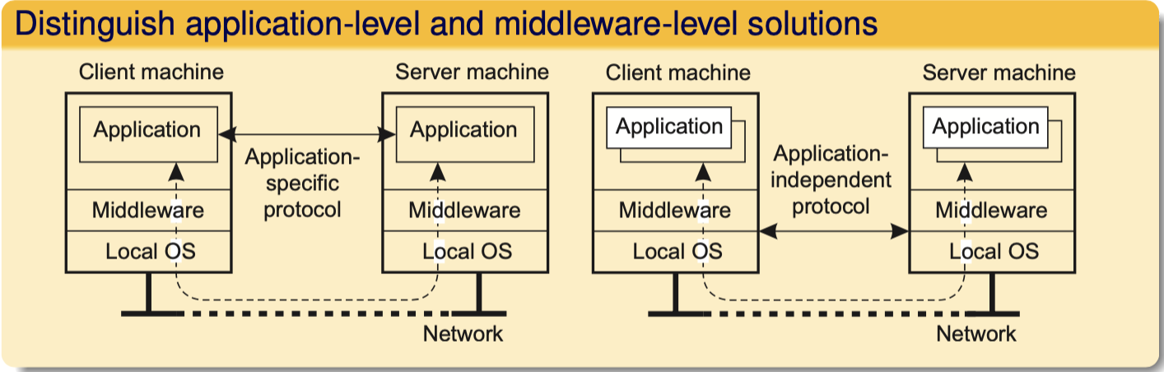
Client-server interaction
Which ones are
more vulnerable to
Problems ?
What multithreaded
process does share?
- A calendar app in a smart phone
synchronizes with the remote
shared calendar
- It needs its own protocol
- The client is used as a terminal with
no need to a local storage
- A general solution to allow access
to remote applications
Notes:
(a) Java runtime environment

Slide 11
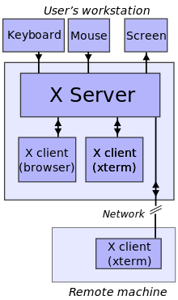
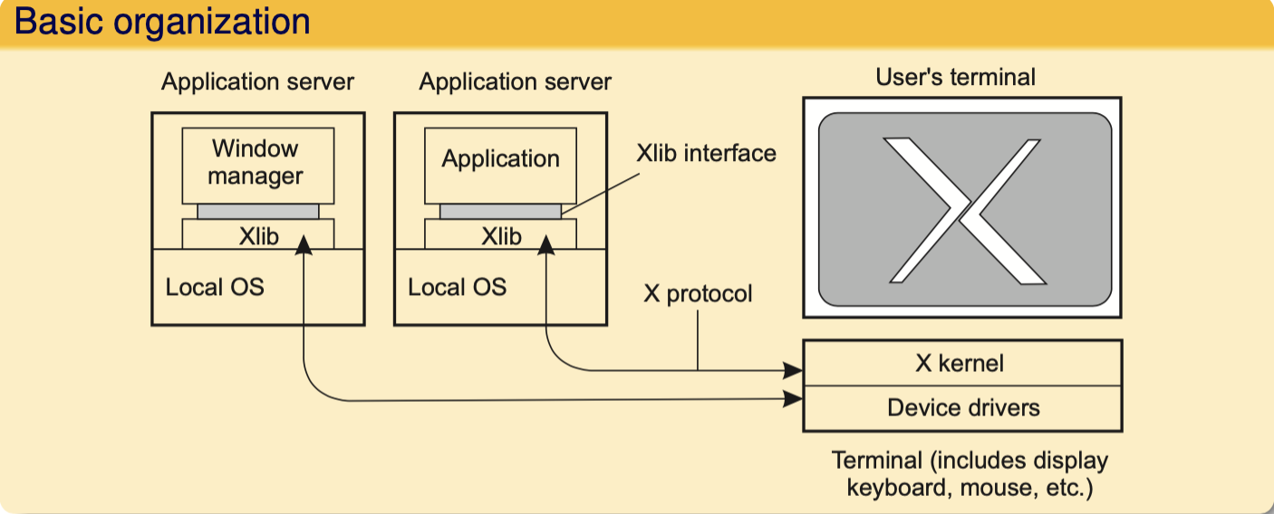
Example: The XWindow System
Which ones are
more vulnerable to
Problems ?
What multithreaded
process does share?
X Client and Server
The application acts as a client to the X-kernel, the latter running as a server on the client’s machine.
Notes:
(a) Java runtime environment

Slide 12

Servers: General organization
Which ones are
more vulnerable to
Problems ?
What multithreaded
process does share?
A process implementing a specific service on behalf of a collection of clients.
It waits for an incoming request from a client and subsequently ensures that the request is taken care of, after which it waits for the next incoming request.
Notes:
(a) Java runtime environment

Slide 13
Servers: Two basic types
Iterative Server
Process one request at a time
Easy to build
Unnecessary delay
Concurrent server
Handles multiple request at one time
More effort is required to design and build
Better performance
Which ones are
more vulnerable to
Problems ?
What multithreaded
process does share?
Observation
Concurrent servers are the norm: they can easily handle multiple requests, notably in the presence of blocking operations (to disks or other servers).
Notes:
(a) Java runtime environment

Slide 14
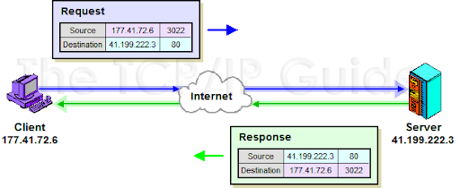
Contacting a server
IP address + Port number = Socket
What multithreaded
process does share?
An Internet Protocol address (IP address) is a numerical label assigned to each device connected to a computer network that uses the Internet Protocol for communication.
A media access control address (MAC address) is a unique identifier assigned to a network interface controller (NIC) for use as a network address in communications within a network segment.
Notes:
(a) Java runtime environment

Slide 15
Out-of-band communication
Issue
Is it possible to interrupt a server once it has accepted (or is in the process of accepting) a service request?
Solution 1: Use a separate port for urgent data
Server has a separate thread/process for urgent messages
Urgent message comes in ⇒ associated request is put on hold
Note: we require OS supports priority-based scheduling
Solution 2: Use facilities of the transport layer
Example: TCP allows for urgent messages in same connection
Urgent messages can be caught using OS signaling techniques
Notes:
(a) Java runtime environment

Slide 16
Stateful or Stateless?
Stateful server
Maintain state of connected clients
Sessions in web servers
Stateless server
No state for clients
Soft state
Maintain state for a limited time; discarding state does not impact correctness
Notes:
(a) Java runtime environment

Slide 17
Servers and state
Stateless servers
Never keep accurate information about the status of a client after having handled a request:
Don’t record whether a file has been opened (simply close it again after access)
Don’t promise to invalidate a client’s cache
Don’t keep track of your clients
Consequences
Clients and servers are completely independent
State inconsistencies due to client or server crashes are reduced
Possible loss of performance because, e.g., a server cannot anticipate client behavior (think of prefetching file blocks)
Question
Does connection-oriented communication fit into a stateless design?
Notes:
(a) Java runtime environment

Slide 18
Servers and state
Stateful servers
Keeps track of the status of its clients:
Record that a file has been opened, so that prefetching can be done
Knows which data a client has cached, and allows clients to keep local copies of shared data
Observation
The performance of stateful servers can be extremely high, provided clients are allowed to keep local copies. As it turns out, reliability is often not a major problem.
Notes:
(a) Java runtime environment

Slide 19
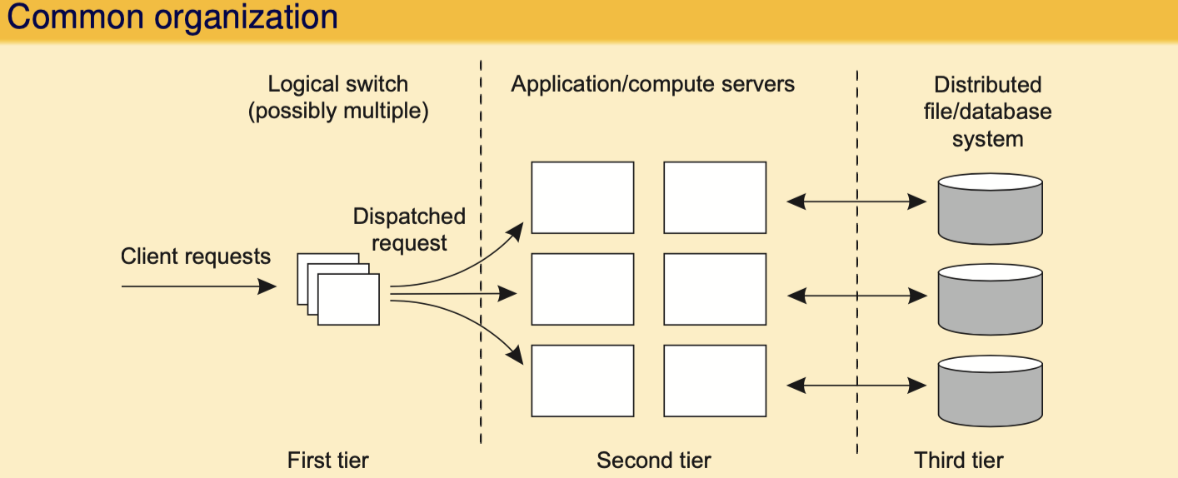
Three different tiers
Crucial element
The first tier is generally responsible for passing requests to an appropriate server: request dispatching
Notes:
(a) Java runtime environment

Slide 20
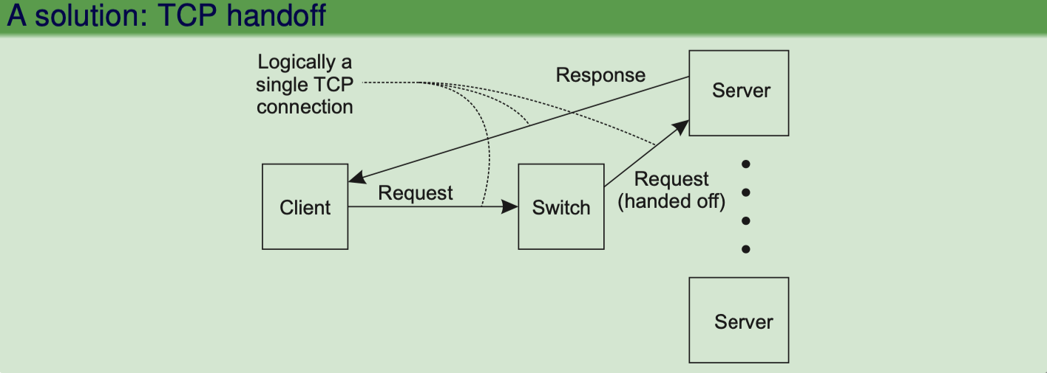
Request Handling
Observation
Having the first tier handle all communication from/to the cluster may lead to a bottleneck.
Notes:
(a) Java runtime environment

Slide 21
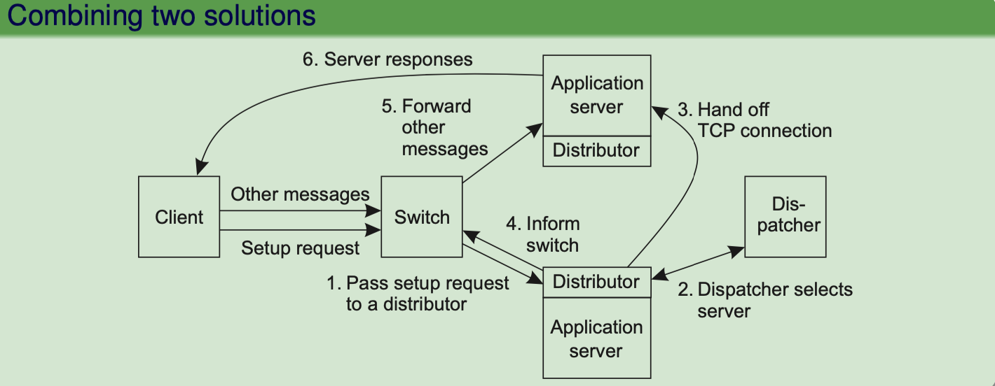
Server clusters
The front end may easily get overloaded: special measures may be needed
Transport-layer switching: Front end simply passes the TCP request to one of the servers, taking some performance metric into account.
Content-aware distribution: Front end reads the content of the request and then selects the best server.
Notes:
(a) Java runtime environment

Slide 22
When servers are spread across the Internet
Observation
Spreading servers across the Internet may introduce administrative problems. These can be largely circumvented by using data centers from a single cloud provider.
Request dispatching: if locality is important
Common approach: use Domain Name System (DNS):
Client looks up specific service through DNS - client’s IP address is part of request
DNS server keeps track of replica servers for the requested service, and returns address of most local server.
Notes:
(a) Java runtime environment

Slide 23
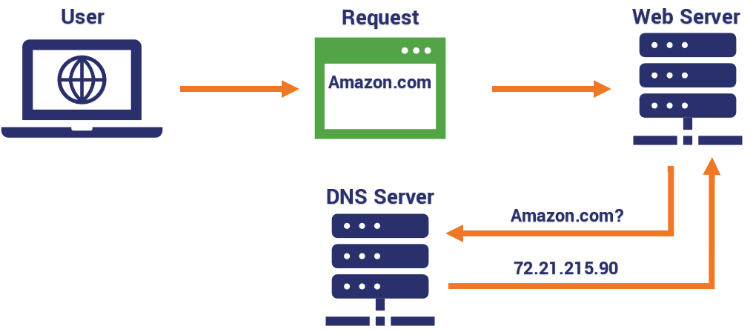
When servers are spread across the Internet
Notes:
(a) Java runtime environment

Slide 24
When servers are spread across the Internet
Observation
Spreading servers across the Internet may introduce administrative problems. These can be largely circumvented by using data centers from a single cloud provider.
Request dispatching: if locality is important
Common approach: use Domain Name System (DNS):
Client looks up specific service through DNS - client’s IP address is part of request
DNS server keeps track of replica servers for the requested service, and returns address of most local server.
Client transparency
To keep client unaware of distribution, let DNS resolver act on behalf of client. Problem is that the resolver may actually be far from local to the actual client.
Notes:
(a) Java runtime environment

Slide 25
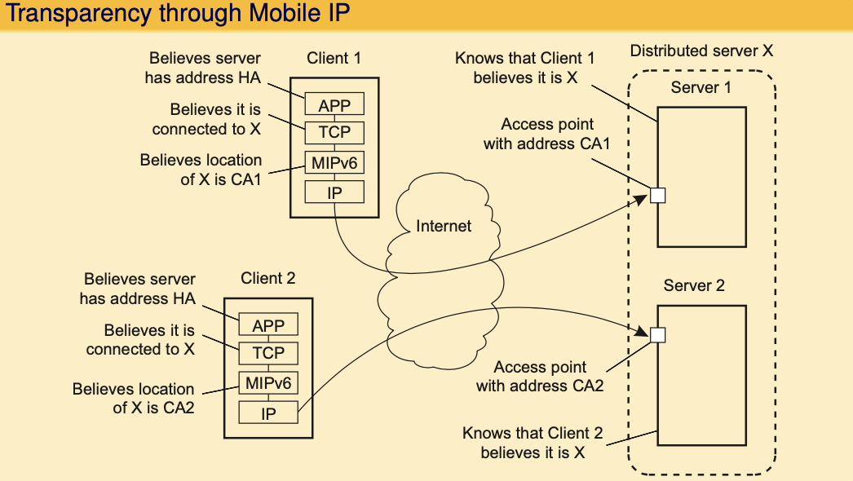
Distributed servers with stable IPv6 address(es)
﻿Route optimization can be used to make different clients believe they are communicating with a single server, where, in fact, each client is communicating with a different member node of the distributed server, as shown
Notes:
(a) Java runtime environment

Slide 26
Case Study: PlanetLab
Essence
Different organizations contribute machines, which they subsequently share for various experiments.
Problem
We need to ensure that different distributed applications do not get into each other’s way ⇒ virtualization
Notes:
(a) Java runtime environment

Slide 27

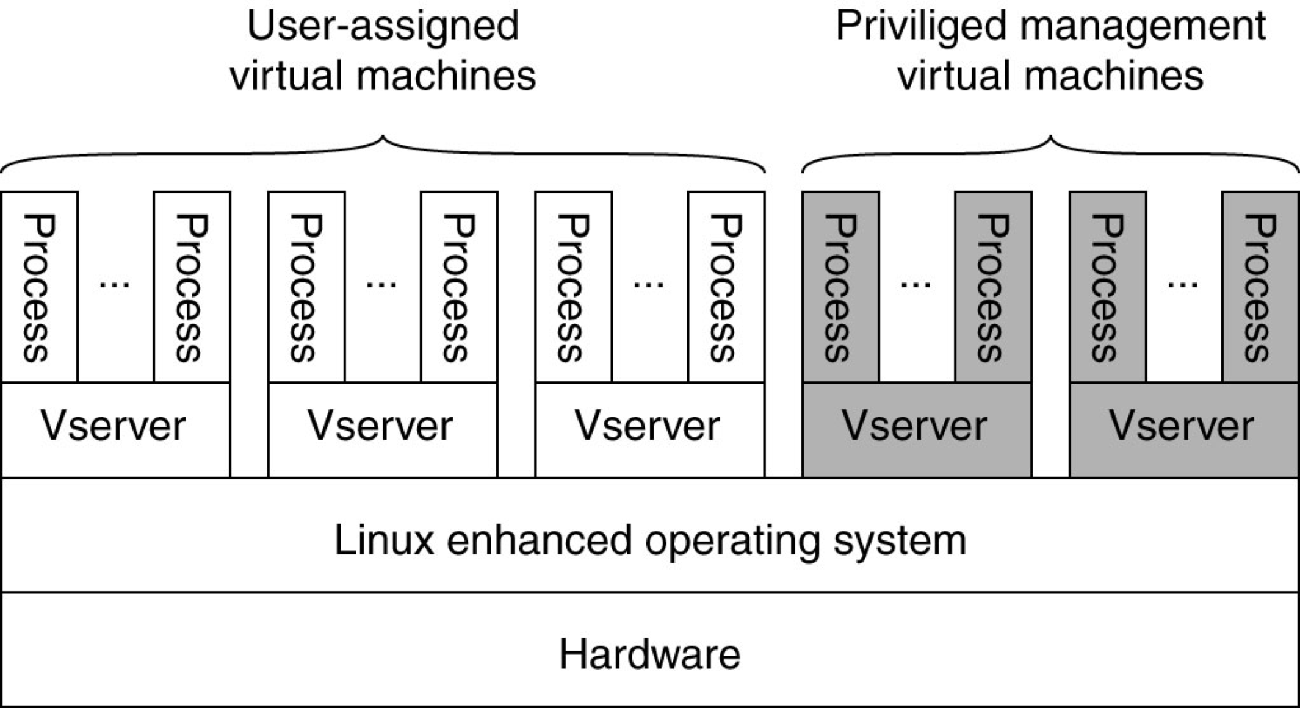
PlanetLab basic organization
Overview
Distributed cluster across universities
Used for experimental research by students and faculty in networking and distributed systems
Uses a virtualized architecture
Linux Vservers
Node manager per machine
Obtain a “slice” for an experiment: slice creation service
Notes:
(a) Java runtime environment

Slide 28
Case Study: PlanetLab
PlanetLab management issues:
Nodes belong to different organizations.
Each organization should be allowed to specify who is allowed to run applications on their nodes,
And restrict resource usage appropriately.
Monitoring tools available assume a very specific combination of hardware and software.
All tailored to be used within a single organization.
Programs from different slices but running on the same node should not interfere with each other.
Notes:
(a) Java runtime environment

Slide 29
Case Study: PlanetLab
Relationships between PlanetLab entities:
A service provider contacts a slice authority to create a slice on a collection of nodes.
The slice authority needs to authenticate the service provider.
A node owner provides a slice creation service for a slice authority to create slices. It essentially delegates resource management to the slice authority.
A management authority delegates the creation of slices to a slice authority.
Notes:
(a) Java runtime environment

Slide 30
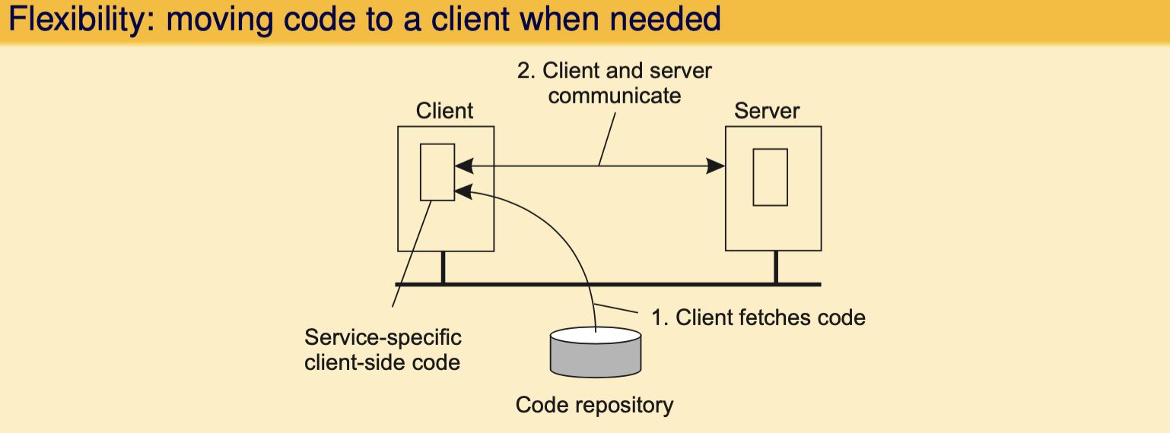
Reasons for Migrating Code
Load distribution
Ensuring that servers in a data center are sufficiently loaded (e.g., to prevent waste of energy)
Minimizing communication by ensuring that computations are close to where the data is (think of mobile computing).
Notes:
(a) Java runtime environment

Slide 31
Strong and weak mobility
Object Component
Code segment: contains the actual code
Data segment: contains the state
Execution state: contains context of thread executing the object’s code
Weak mobility: Move only code and data segment (and reboot execution)
Relatively simple, especially if code is portable
Distinguish code shipping (push) from code fetching (pull)
Strong mobility: Move component, including execution state
Migration: move entire object from one machine to the other
Cloning: start a clone, and set it in the same execution state
Notes:
(a) Java runtime environment

Slide 32
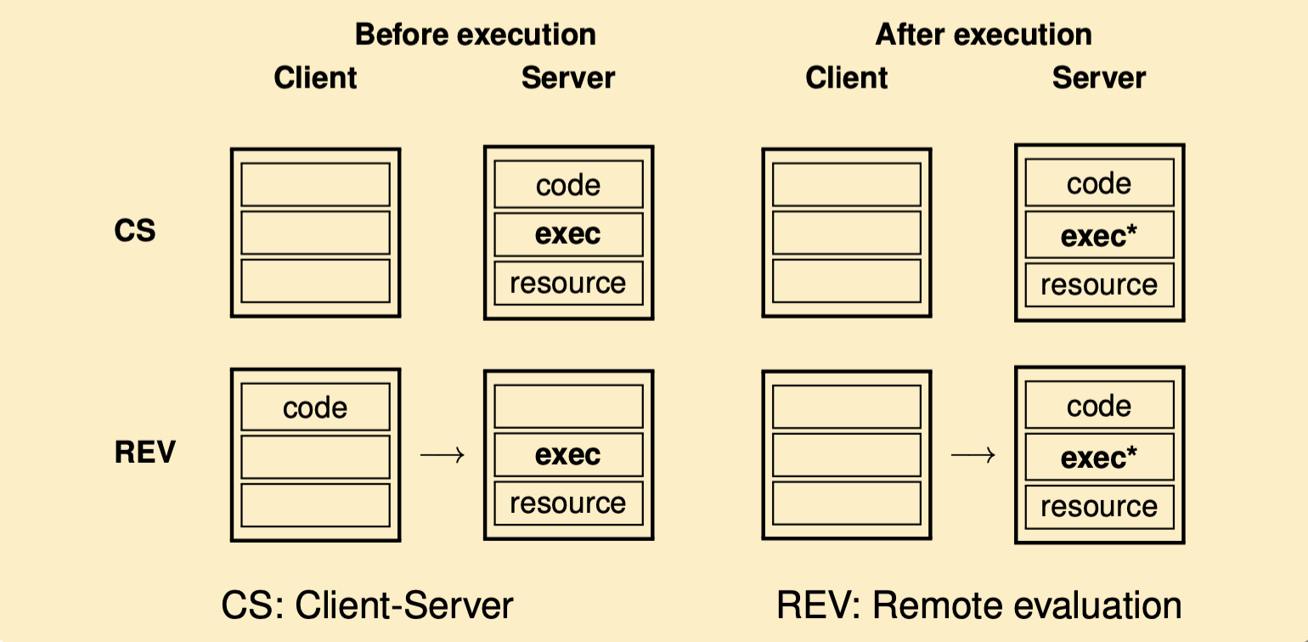
Models for code migration
Notes:
(a) Java runtime environment

Slide 33
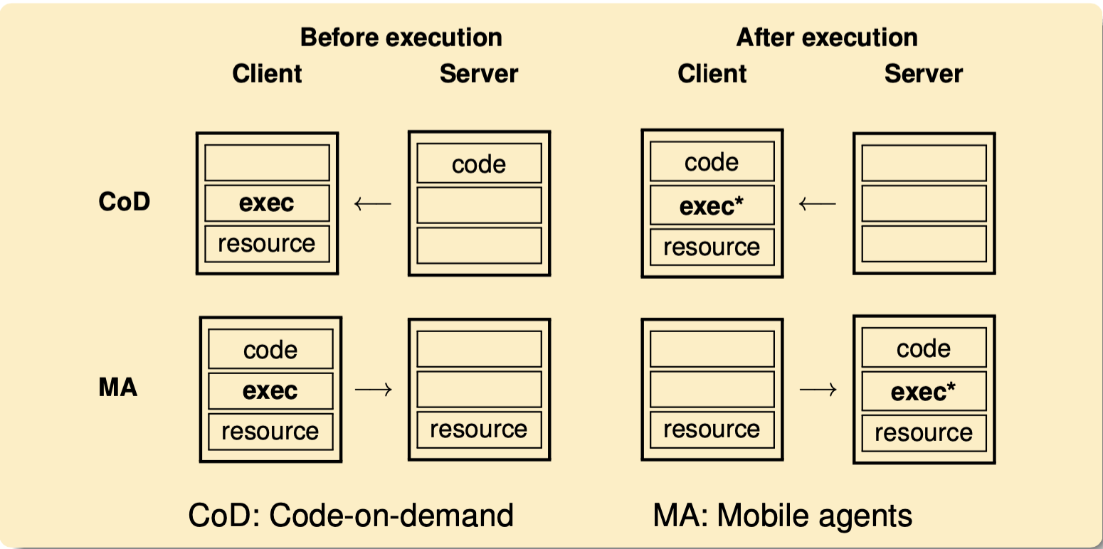
Models for code migration
Notes:
(a) Java runtime environment

Slide 34
Migration in heterogeneous systems
Main problem
The target machine may not be suitable to execute the migrated code
The definition of process/thread/processor context is highly dependent on local hardware, operating system and runtime system
Only solution: abstract machine implemented on different platforms
Interpreted languages, effectively having their own
VM Virtual machine monitors
Notes:
(a) Java runtime environment

Slide 35
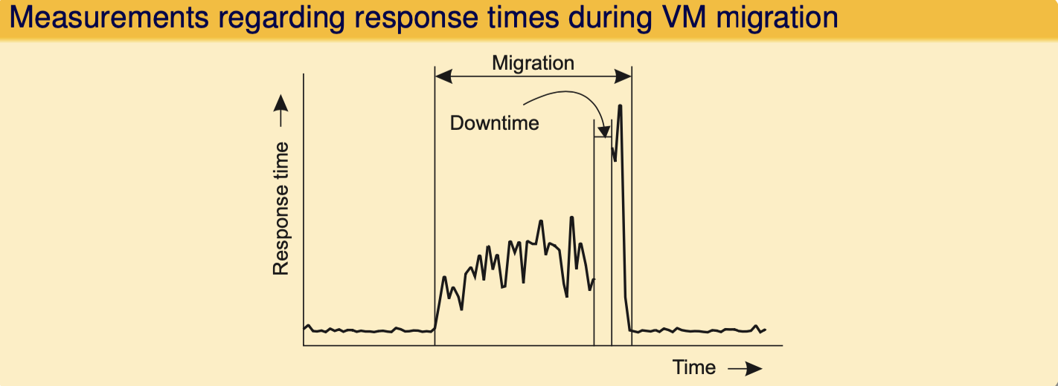
Performance of migrating virtual machines
Main problem
A complete migration may actually take tens of seconds.
We also need to realize that during the migration, a service will be completely unavailable for multiple seconds.
Notes:
(a) Java runtime environment

Slide 36
Scalability
Question: How can you scale the server capacity?
Buy bigger machine!
Replicate
Distribute data and/or algorithms
Ship code instead of data
Cache
Notes:
(a) Java runtime environment

Slide 37
A To-Do List
Read Chapters 3.3, 3.4, 3.5
Start building your team

